Slide 1
Computer Networks
CSE-AIT
CHAPTER 1.1
ALOK KUMAR – ASSISTANT PROFESSOR & KARGIL TECHINCAL TRAINER (DCPD)
EMAIL: DCPD.KARGILT1@CUMAIL.IN

Slide 2
Contents
Network & its types, Uses of Computer Network
Data Transmission
Network Architecture
Network Topologies & architecture
Networking Devices Introduction: Hub, Switch and Routers.

Slide 3
Need of Computer Networks?
Imagine a bank in the 1970s with five computers. If Computer A had a file that Computer B needed, an employee had to copy that file onto a magnetic tape or a floppy disk, physically walk across the room, and insert it into Computer B. This manual process is historically called "Sneakernet“.
The Problem of Resource Costs: In the early days, printers and storage drives were incredibly expensive. A company could not afford to buy a dedicated printer for every single computer.
The Engineering Solution: Computer networks were invented to solve these specific problems by creating electronic pathways between machines.
Needs:
Resource Sharing
High Reliability & Fault Tolerance
Scalability and Cost Reduction
Instantaneous Communication

Slide 4
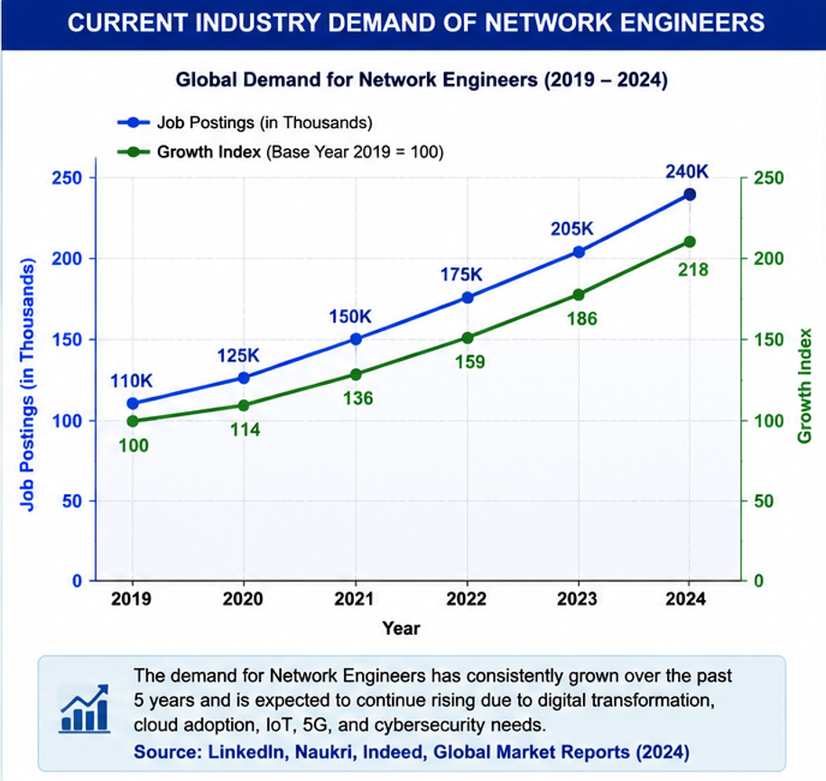

Slide 5
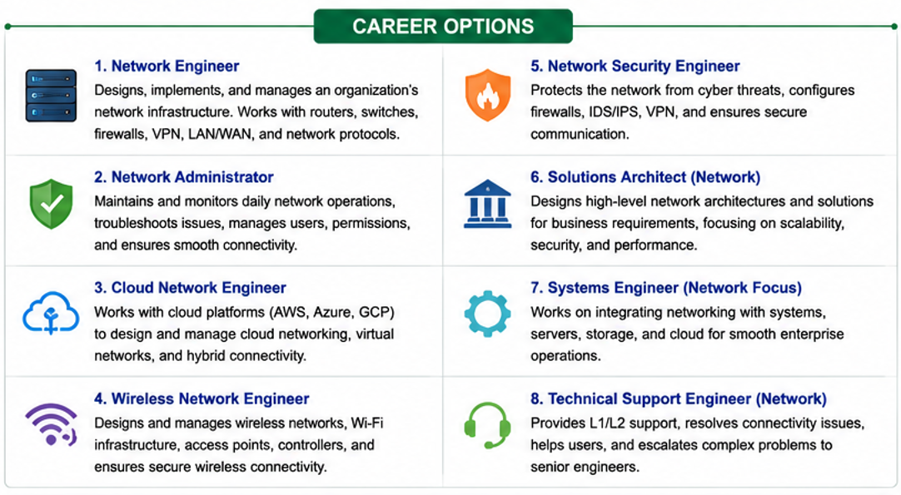

Slide 6


Slide 7
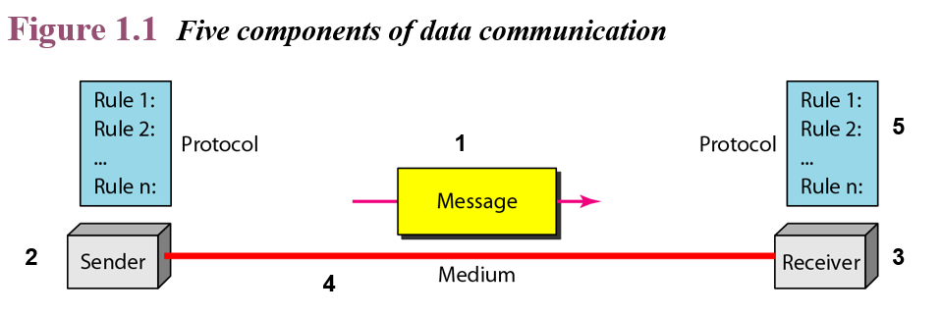
Computer Network
A computer network is an interconnected collection of autonomous computing devices that use a shared set of rules (protocols) to exchange data over a physical or wireless transmission medium.
What does "Autonomous" mean?
Autonomous means each computer retains its own independent control. A network is not a system where a master computer controls a "dumb" terminal. No computer on a network can forcefully start, stop, or reboot another computer without explicit, programmed permission.
What is a Node?
A node is any device connected to a network that can send, receive, or forward data. This includes your laptop, a smartphone, a network printer, a smart TV, or a router.

Slide 8
Core Structural Components
Sender & Reciever: The starting and ending points of data (computers, phones, cameras).
Transmission Media: The physical pathways that carry bits (guided media like copper wires and fiber-optic cables, or unguided media like radio waves and Wi-Fi).
Network Devices: The intermediate hardware components that direct and shape traffic (hubs, switches, and routers).
Protocols: The strict, standardized rulebooks that govern how data is formatted, timed, and verified across the medium (such as TCP/IP, HTTP, and Ethernet rules).

Slide 9
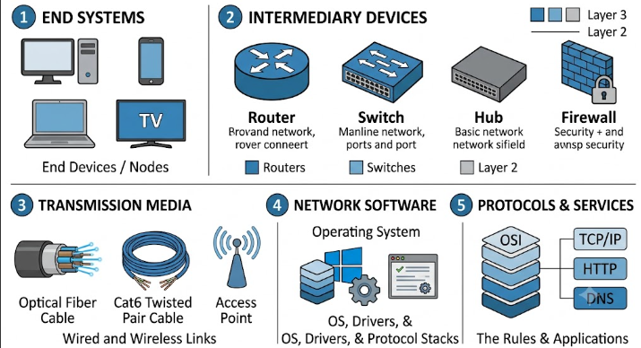
Components of a Computer Network

Slide 10
Characteristics of Good Network
Reliability: The network should work continuously without frequent failures.
Speed: Data should travel quickly.
Security: Data should be protected from unauthorized users.
Scalability: The network should allow new computers to be added easily.
Performance: The network should perform efficiently even when many users are connected.

Slide 11
Network Types: PAN, LAN, CAN, MAN, & WAN
Personal Area Network(PAN)
A Personal Area Network (PAN) is a computer network that connects the personal devices of a single user within a short distance, usually up to 10 meters, for the purpose of sharing data and resources.
Coverage Area: 1 to 10 meters.
Characteristics of PAN
Very small coverage area.
Used by a single person.
Low installation cost.
Easy to create and manage.
Supports both wired and wireless communication.
Connects personal electronic devices.
Usually does not require expensive networking equipment.
Examples
A student connects Bluetooth headphones to a mobile phone.
A laptop connects to a wireless mouse and keyboard.

Slide 12
Network Types: PAN, LAN, CAN, MAN, & WAN
2. Local Area Network (LAN)
Geographical Range: Small and highly localized. Typically restricted to a single room, a home, one office building, or a university campus (usually ranging from a few meters up to 1-2 Kilometers
Ownership: A LAN is privately owned by a single individual or organization. For example, your university owns every wire and router on its campus.
Hardware Used: Primarily built using Cat6/Cat7 Twisted Pair cables for wired connections (Ethernet under the IEEE 802.3 standard) and wireless access points (Wi-Fi under the IEEE 802.11 standard).
Because the distances are short and the equipment is privately managed, LANs have extremely high data speeds (100 Mbps to 10 Gbps) and incredibly low error rates (data rarely gets corrupted because there is no external interference).
Example 1: A computer lab in your engineering department where 50 desktop PCs are plugged into a central switch
Example 2: Your home setup, where your smartphone, laptop, and Smart TV are all connected wirelessly to your home Wi-Fi router.

Slide 13
Network Types: PAN, LAN, CAN, MAN, & WAN
2. Metropolitan Area Network (MAN)
Geographical Range: Larger than a LAN but smaller than a WAN. It covers an entire town, city, or a large municipal region (5 km to 50 km)
Ownership: Often owned by a consortium of businesses, a municipal government, or a single massive service provider (like a telecom company operating inside a city).
Hardware Used: Because it spans an entire city, copper wires are too slow and inefficient. MANs are built using high-speed Optical Fiber Cables (OFC) running underground or attached to telephone poles, alongside high-power microwave wireless towers.
A MAN essentially acts as an aggregator. It links multiple distinct LANs spread across a town together so they can share data without passing through the slower public internet.
Example 1: A city's centralized traffic police surveillance system. Hundreds of CCTV cameras installed at different intersections across New Delhi or Mumbai stream video back to a single central police headquarters.
Example 2: A local Cable TV network. A central office receives satellite signals and distributes them via underground cables to thousands of homes across a city.

Slide 14
Network Types: PAN, LAN, CAN, MAN, & WAN
3. Wide Area Network (WAN)
Geographical Range: Vast, unbounded geographical scale. It spans across multiple states, entire countries, continents, or the entire planet (extending thousands of kilometers).
Ownership: No single entity owns a WAN. Instead, it is a massive, complex cooperative network of leased lines owned by telecom giants, governments, and Internet Service Providers (ISPs like Jio, Airtel, AT&T).
Hardware Used: WANs rely on long-haul transmission infrastructure. This includes undersea transoceanic optical fiber cables dropped directly to the ocean floor to connect continents, and geostationary communication satellites orbiting Earth to transmit data to remote regions.
Technical Insights: Because data must travel across thousands of kilometers of public infrastructure, WANs suffer from high propagation delay (the time it takes for a signal to physically travel from source to destination) and higher error rates due to environmental factors, meaning data packets frequently get lost or damaged along the way.
Example 1: The Internet. It is the ultimate, largest wide area network on Earth, connecting billions of smaller LANs and MANs together.

Slide 15
Factor / Feature | Local Area Network (LAN) | Metropolitan Area Network (MAN) | Wide Area Network (WAN)
Geographic Span | Very Small (1 meter to 2km). | Medium (5km}$ to 50km). | Very Large (Global / Continents).
Data Speed | Extremely High (100Mbps to 10 Gbps) | Moderate to High (10 Mbps to 1 Gbps) | Lower to Moderate (1 Mbps to 100 Mbps dynamically)
Propagation Delay | Negligible (Near instantaneous). | Moderate. | High (Due to massive long-distance travel).
Error Rate | Very Low (Very clean, uncorrupted signals). | Moderate. | High (Requires heavy error checking).
Primary Media | Twisted Pair (Cat6), Wi-Fi (802.11). | Optical Fiber (OFC), Microwave links. | Undersea Fiber Cables, Satellites.
Cost to Setup | Low and highly affordable. | High (Requires trenching roads for fiber). | Extremely High (Requires global telecom infrastructure).

Slide 16
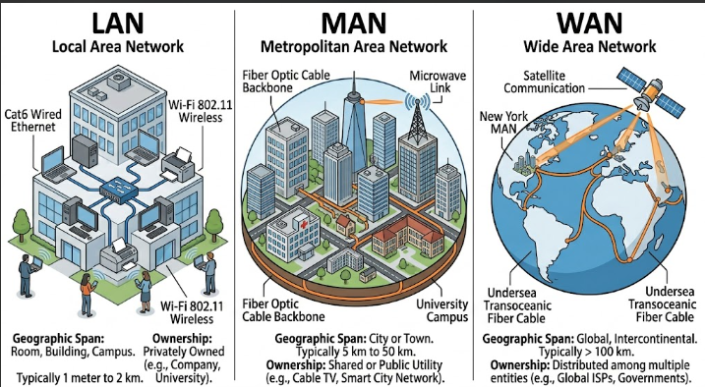

Slide 17
Data Transmission
Once we have connected multiple autonomous computers together into a network (whether it is a LAN, MAN, or WAN), we face a fundamental engineering question: How exactly do the electronic bits travel across the path? If two computers try to talk over a wire at the exact same millisecond without clear transmission rules, their electrical signals will collide, scramble each other, and turn into useless data noise.
We need highly specific rules to dictate the direction of data flow, the timing of the bits, and the physical layout of the lines. Understanding data transmission concepts gives engineers the blueprints needed to select the right cables, network cards, and protocols for any given business application.

Slide 18
Transmission Modes – Based On Direction
This classification determines how data flows between two connected nodes with respect to time.
1. Simplex Mode:
Def.: Communication is strictly unidirectional (a one-way street). One pre-assigned device acts purely as the transmitter, and the other acts purely as the receiver.
The Mechanism: The entire bandwidth of the physical channel is dedicated to moving data in that single direction. The receiver has no hardware capability to reply or send feedback.
Example: A traditional television broadcast station sending signals to your home TV antenna, or a computer sending characters to a basic desktop monitor.

Slide 19
Transmission Modes
Advantages:
Simple Communication
Low Cost
Full Channel Capacity
Suitable for Broadcasting
Disadvantages:
No feedback
No Error Confirmation
One way communication only

Slide 20
Transmission Modes
2. Half-Duplex Mode
Def.: Communication is bidirectional, but not at the same time. Both devices can transmit and receive, but only one can speak at a any given instant.
The Mechanism: The two devices share a single physical transmission channel. When Device A transmits, Device B must switch its network card to listening mode. If both try to transmit simultaneously, a collision occurs.
Example: A Walkie-Talkie radio system (where you must press a button to talk, say "Over" to clear the line, and release the button to listen), or classic legacy Ethernet hubs.

Slide 21
Transmission Modes
Advantages:
Two-Way Communication
Better utilization than Simplex
Lower Cost
Disadvantages:
Cannot communicate simultaneously.
Delay in communication
Lower Peformance

Slide 22
Transmission Modes
3. Full-Duplex Mode
The Rule: Communication is completely simultaneous and bidirectional. Both devices can transmit and receive data at the exact same time.
The Mechanism: The physical transmission medium is split into two separate electrical pathways—one for outbound traffic and one for inbound traffic—or the channel uses advanced frequency division to isolate the two streams.
Real-World Example: A standard mobile phone telephone call where both people can talk and hear each other simultaneously, or modern high-speed switched Ethernet links.

Slide 23
Transmission Modes – Based on Transmission Method
Feature | Serial Transmission | Parallel Transmission
Number of Bits Sent | One bit at a time | Multiple bits simultaneously
Communication Lines | One | Multiple
Cost | Low | High
Speed (Short Distance) | Lower in traditional systems | Higher
Long-Distance Communication | Excellent | Poor
Signal Interference | Very Low | Higher
Installation | Easy | Difficult
Reliability | High | Lower over long distances
Modern Usage | Internet, USB, Ethernet, Fiber | Short-distance internal communication, legacy interfaces

Slide 24
Transmission Modes – Based on Data Synchronization
1. Asynchronous Transmission
2. Synchronous Transmission
In asynchronous transmission, the sender and receiver do not share a common clock signal.
Instead, each character is sent independently.
To help the receiver identify the beginning and end of each character, Start and Stop bits are added.
[half-duplex]
In synchronous transmission, the sender and receiver share a common timing reference. [
Instead of sending one character at a time, data is transmitted as a continuous stream of bits.
No Start or Stop bits are added to every character.
[Full Duplex]
Characteristics of Asynchronous Transmission
Data is sent one character at a time.
Each character has its own Start and Stop bits.
No common clock is required.
Gaps may exist between characters.
Simple to implement.
Suitable for low-speed communication.
Characteristics of Synchronous Transmission
Data is sent continuously.
Characters are grouped into frames.
Sender and receiver remain synchronized.
Higher transmission speed.
More efficient than asynchronous transmission.
Suitable for large amounts of data.

Slide 25
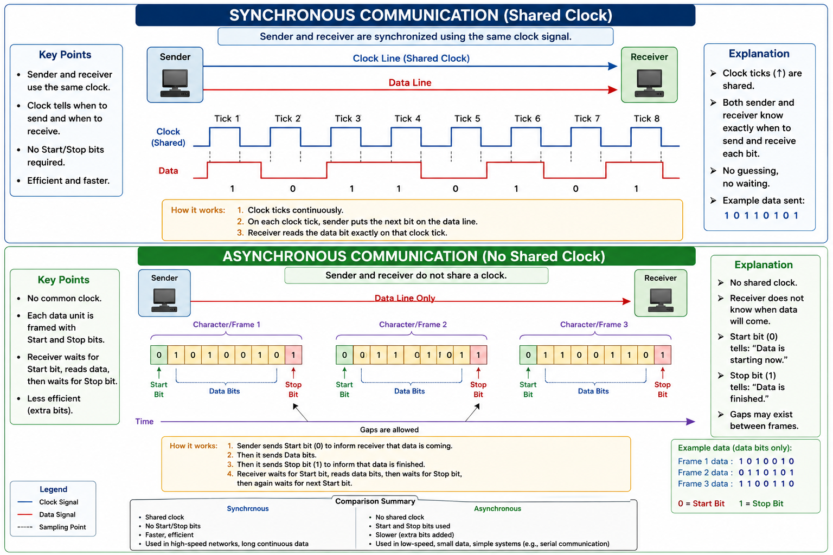

Slide 26
Network Architecture: Client-Server
In computer networking, architecture refers to the logical design of the network applications and how tasks are distributed among the connected hosts. There are two primary models;
A. Client-Server Architecture
The Core Mechanism: This model establishes a strict hierarchical relationship. The network is sharply divided into two distinct roles:
  The Server: A high-performance, dedicated machine equipped with massive processing power, large memory arrays, and a specialized Network Operating System (NOS). It sits in a centralized location, constantly listening for incoming requests over the network. It manages data storage, security, authentication, and application processing.
  The Client: A standard personal computer, laptop, or mobile device used by an individual end-user. Clients do not share their resources with anyone else. Instead, they contact the central server to request web pages, pull database records, check emails, or validate login credentials.
Administrative Control: Completely centralized. The server administrator controls who has access to the network resources. All security patches, software updates, and file backups happen directly on the central server.
Real-World Examples: Accessing web pages via an HTTP Web Server, pulling corporate employee records from an SQL Database Server, or accessing files from an enterprise Cloud Storage Server.

Slide 27
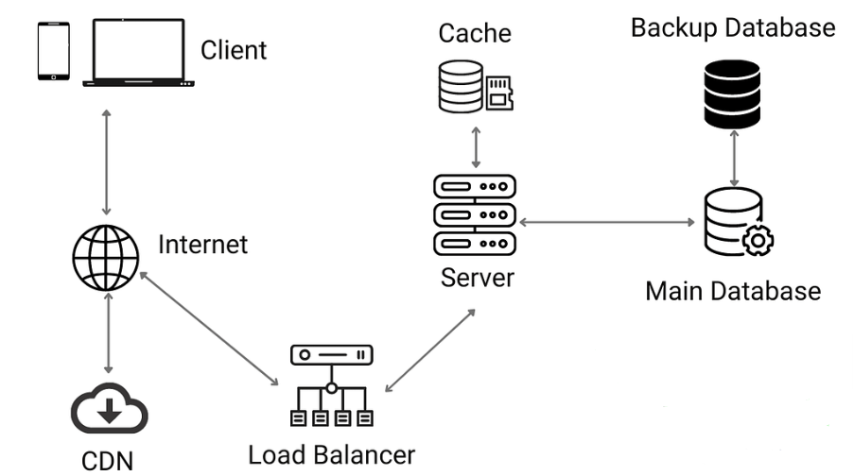
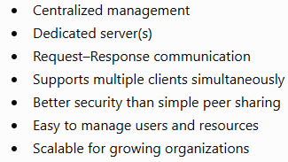
Network Architecture: Client-Server

Slide 28
Network Architecture: Peer-to-Peer(P2P)
B. Peer-to-Peer (P2P) Architecture
The Core Mechanism: This model is completely democratic and non-hierarchical. There is no specialized, central master server. Instead, every single computer plugged into the network acts as a Peer (also referred to as a Servent, a combination of Server and Client).
The Dual Role: At any given second, a peer computer can act as a client by downloading a file chunk from another machine, while simultaneously acting as a server by uploading a different file chunk to a third machine on the network. Every computer contributes its own local hard drive space, processing power, and bandwidth to the collective pool.
Administrative Control: Completely decentralized. Every individual peer is responsible for its own local security setup, user permissions, and file backups. There is no central point of failure.
Real-World Examples: BitTorrent file-sharing systems, blockchain networks, and small office workgroups linking a handful of computers together to share a local office printer.

Slide 29
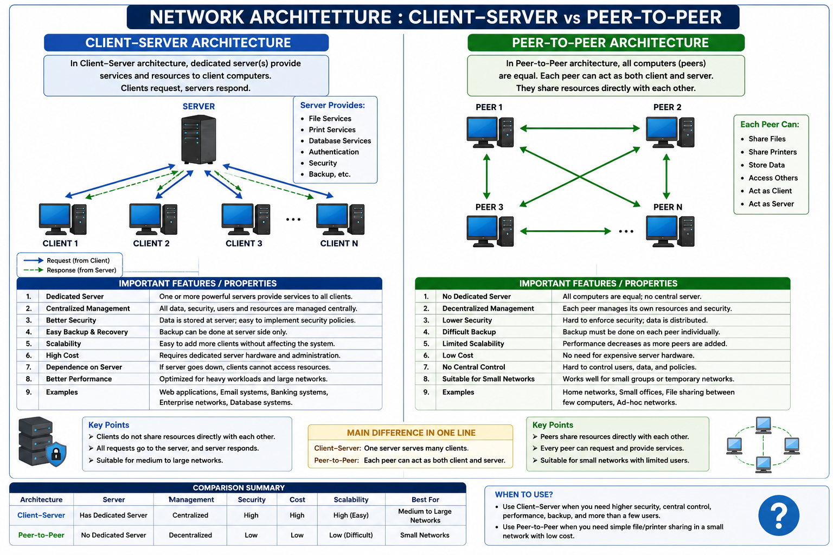

Slide 30
Model Type | Why it is Good (Advantages) | Where it Fails (Disadvantages)
Client-Server | - Centralized backup systems ensure no data loss. - Highly secure; access permissions are tightly controlled. - Scales up smoothly to support thousands of concurrent users across great distances. | - Single Point of Failure: If the central server crashes, the entire network goes down instantly. - High implementation and maintenance costs. - Requires dedicated network administrators to configure.
Peer-to-Peer | - Incredibly cost-effective; no expensive server hardware or software licenses needed. - Highly robust and resilient; if one peer drops offline, the rest of the network keeps running perfectly. - Simple to set up and manage without professional IT expertise. | - Decentralized security makes it highly vulnerable to data breaches or virus infections across nodes. - No centralized backup; if a user deletes a file on their local machine, it is gone permanently. - Performance drops drastically as more nodes join, creating data tracking chaos.

Slide 31
Concept of Topologies & its Types
Before laying down wires or setting up wireless transmitters, network engineers must strategically plan the structural layout of the network. Without a definitive blueprint, connecting devices would lead to a chaotic web of cables. This causes major issues:
High Costs: Using more cabling than necessary wastes money.
Signal Collisions: If multiple devices dump data onto a single unmanaged wire at the same exact time, the electrical signals collide and destroy each other.
Troubleshooting Nightmares: If a wire breaks somewhere in a giant building, finding the exact point of failure without a known geometric plan is nearly impossible.

Slide 32
Network topology is the structural arrangement, layout, or geometric configuration of a computer network, defining how nodes (devices) and links (communication channels) are organized and interconnected.
The Two Types of Topology:
Physical Topology: The actual, physical layout of the cables, wires, and hardware devices. It is what you can physically see and touch.
Logical Topology: The path that data signals actually travel through those wires. For example, a network might look like a Star physically, but behave like a Ring logically.

Slide 33
Mesh Topology
In a fully connected Mesh topology, every individual node has a dedicated, point-to-point link to every other node in the network. A dedicated link means that the communication channel carries traffic exclusively between those two specific devices.
Equations for Mesh Topology: For a network containing n nodes:
  Physical Input/Output (I/O) Ports Needed Per Device: Ports = n - 1
  Total Number of Physical Duplex Links(Cables) Required: Links = (n * (n - 1)) / 2
Example: If a network consists of 5 nodes arranged in a fully connected Mesh topology:
Each node requires 5 - 1 = 4 physical ports.
The total number of cables required is (5 * (5 - 1)) / 2 = 20 / 2 = 10 cables.
If the network scales to 100 nodes, each node requires 99 ports, and the total number of cables scales to (100 * 99) / 2 = 4,950 cables.

Slide 34
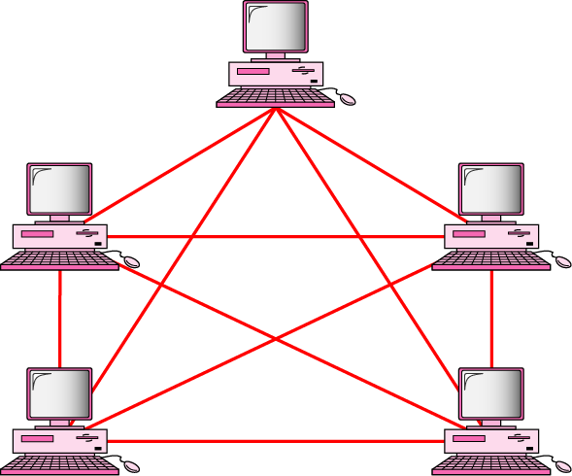
Fig: Mesh Topology
n(n-1)/2 physical duplex links

Slide 35
Mesh Topology
Advantages | Disadvantages
- Maximum Fault Tolerance: If an individual link snaps, it only interrupts communication between those two specific nodes. The rest of the network remains operational. - Privacy and Security: Dedicated lines prevent unauthorized node interception. - Zero Traffic Congestion: Dedicated lines eliminate data traffic contention or sharing delays. | - High Cable Volume: Requires substantial physical wiring, leading to a complex installation layout. - Hardware Port Constraints: Nodes are physically limited by the number of hardware I/O ports they can support. - High Capital Expenditure: Massive deployment and material costs.

Slide 36
Star Topology
In a Star topology, each node connects directly to a central controller via a dedicated point-to-point link. This central controller is typically a Hub or a Switch. Nodes do not maintain direct physical connections with one another.
Traffic Flow Mechanism: When Node A transmits data to Node B, the signal travels along Node A's dedicated cable to the central switch. The switch processes the destination address and forwards the signal along Node B's dedicated cable.
Real-World Examples:
Example 1: Standard modern university computer labs or enterprise office floors where every desktop PC connects via a Cat6 Ethernet cable to a central switch rack.
Example 2: Home Wi-Fi setups where smartphones, laptops, and smart TVs communicate through a central wireless home router.

Slide 37
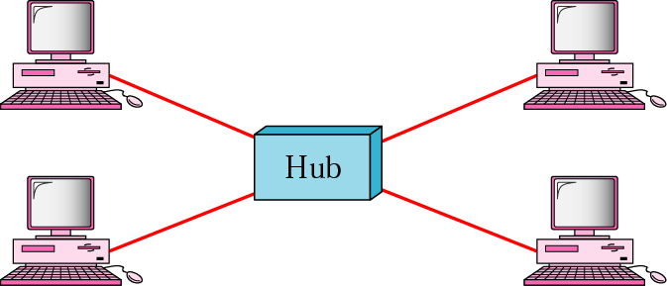
Fig: Star Topology

Slide 38
Star Topology
Star Topology Advantages | Star Topology Disadvantages
- High Scalability: New nodes can be added or existing nodes removed easily without disrupting active network operations. - Isolated Faults: A broken cable only disconnects the attached node; the rest of the network continues to function normally. - Centralized Management: Network traffic can be easily monitored and controlled directly from the central switch. | - Single Point of Failure: If the central Switch experiences a hardware crash or power loss, the entire network fails completely. - Cabling Expenses: Requires a unique cable run from every single device to the center room, consuming more wire length than a Bus topology.

Slide 39
Bus Topology
Bus topology is a multipoint configuration. It utilizes one continuous central cable, known as the backbone, which serves as a shared communication medium for all connected devices.
Drop Lines and Taps: Nodes connect to the main backbone cable via drop lines (secondary cables) and taps (connectors that interface directly with the metallic core of the backbone).
Signal Absorption via Terminators: Hardware components called terminators must be placed at both open ends of the backbone cable. Electrical data signals travel down the wire as waves. When a wave reaches the open end of a wire, it creates a reflection (Signal Reflection) that travels backward, causing data corruption. Terminators contain resistors that match the characteristic impedance of the cable, absorbing the electrical energy and preventing signal reflection.
Real-World Examples:
Example 1: Early legacy Ethernet installations (10Base2 and 10Base5 co-axial systems) used in the 1980s.
Example 2: Automotive internal wiring setups, such as the Controller Area Network (CAN bus) standard that links a vehicle's engine control unit, dashboard sensors, and anti-lock brakes over a single wire pair.

Slide 40
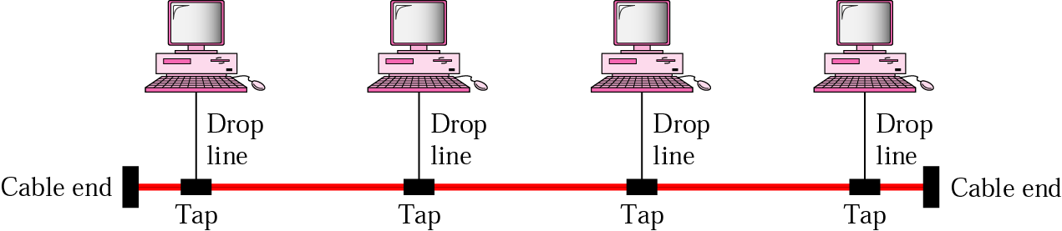
Fig: Bus Topology

Slide 41
Bus Topology
Bus Topology Advantages | Bus Topology Disadvantages
- Low Installation Cost: Requires the minimum total cable length compared to other layouts. - Simple Architecture: Easy to deploy and extend for small-scale environments. | - Throughput Degradation: High traffic volumes increase signal collisions, lowering network throughput significantly. - Difficult Troubleshooting: Pinpointing a faulty tap or line break along a shared cable requires specialized diagnostic tools. - Backbone Vulnerability: A break anywhere along the main backbone splits the network, causing total operational failure.

Slide 42
Ring Topology
In a Ring topology, each node connects to exactly two neighboring nodes, establishing a closed, continuous physical loop.
Signal Regeneration: Data packets travel around the ring in a single direction (Unidirectional). Every node features an electronic repeater. When a node receives a data packet, it reads the destination address. If the packet is intended for a different node, the local node regenerates the electrical signal to maximum strength before passing it to the next adjacent node.
Actual Working & Data Transmission: Data packets travel around the ring in a single direction (Unidirectional). To prevent collisions, many ring networks use a Token Passing mechanism. A small control frame called a "token" circulates the ring constantly. A node can only transmit data when it captures the free token. It attaches its data packet and the destination address to the token and sends it out. Each node acts as an electronic repeater—it receives the signal, amplifies it back to maximum strength, checks the destination, and if it's not the target, passes it to the next adjacent node. When the destination node receives it, it copies the data and sends the token back around to the source to acknowledge receipt.

Slide 43

Fig: Ring Topology

Slide 44
Ring Topology
Ring Topology Advantages | Ring Topology Disadvantages
- Deterministic Traffic Management: Unidirectional data flow and token passing eliminate signal collisions. - High Performance Under Load: Performs better than Bus topology under high traffic congestion. | - High Propagation Delay: Data must pass through multiple intermediate nodes to reach a distant destination. - High Vulnerability: A single broken wire or an unpowered node opens the circuit, halting all network communication.
Real-World Examples:
Example 1: Fiber Distributed Data Interface (FDDI) token ring networks used historically for high-speed campus backbones.
Example 2: Synchronous Optical Network (SONET) ring systems utilized by metropolitan telecommunication providers across cities.

Slide 45
Hybrid Topology
A Hybrid topology is the integration of two or more distinct topologies into a single network infrastructure. It is deployed when a network must expand beyond the physical limits of a single geometric configuration.
Example (Star-Bus): Multiple individual departments may deploy a Star topology connecting to local switches. These separate central switches are then interconnected along a single primary Bus backbone that links the different floors of a building.
Hybrid Topology Advantages | Hybrid Topology Disadvantages
- Maximum Flexibility: Can be custom-designed to match the exact structural layout of any building or campus. - High Scalability: Allows easy expansion by appending new topological segments without altering existing network zones. | - Architectural Complexity: Designing the interfaces, hubs, and routers to bridge different topologies requires highly complex configuration. - High Maintenance Cost: Requires specialized network administrators capable of managing multiple different standard systems simultaneously.

Slide 46
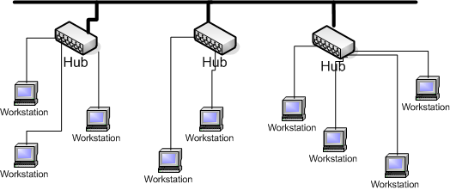
Fig: Hybrid / Tree Topology

Slide 47
Networking Devices Introduction: HUB
A. Hub (Legacy Multi-port Broadcast Device)
Operating Layer: Layer 1 (Physical Layer). It has zero software intelligence and cannot read addresses.
Core Functionality: It acts as a passive packet-replicator. When a data packet enters one port, the hub blindly duplicates it and broadcasts it out of every other active port on the device.
Transmission Mode: Strictly Half-Duplex. Only one machine can send a packet at any given instant. If two machines send packets simultaneously, they collide and get destroyed.
Logical Working Mechanism: 1. Node A sends a data packet intended strictly for Node B into Port 1. 2. The hub receives the packet on Port 1. Because it cannot read the destination address, it blindly broadcasts the packet out of Port 2, Port 3, and Port 4. 3. Node B reads the destination address in the header and processes it. Node C and Node D realize the address does not match theirs and drop the packet.

Slide 48
B. Switch (Intelligent Local Network Device)
Operating Layer: Layer 2 (Data Link Layer). It is an address-aware, packet-filtering device.
Core Functionality: It performs selective packet forwarding and filtering to optimize local network traffic.
The MAC Address Table (CAM Table): The switch maintains a dynamic lookup table in memory. This table maps specific physical ports to the unique MAC Addresses (Hardware Addresses) of the connected hosts.
Domain Classifications: Every individual port represents its own separate Collision Domain. However, all ports still default to a Single Broadcast Domain.
Transmission Mode: Full-Duplex. Because ports are isolated, hosts can send and receive data packets simultaneously without any collisions.
Logical Working Mechanism:
  Learning: When Node A sends a packet into Port 1, the switch reads the Source Address and logs that Node A is on Port 1.
  Lookup: The switch inspects the Destination Address of the packet and checks its internal table.
  Unicast Forwarding: If the destination address is found (e.g., mapped to Port 3), the switch forwards the packet strictly out of Port 3.
  Flooding: If the destination address is missing from the table, the switch sends the packet to every port except the one it arrived on until it learns where that device lives.

Slide 49
C. Router
Operating Layer: Layer 3 (Network Layer).
Core Functionality: It acts as an inter-networking gateway responsible for connecting entirely different networks together (such as routing traffic between a private home network and the public global Internet).
The Routing Table: Routers maintain a software Routing Table containing destination network paths. It executes routing algorithms to compute the mathematically shortest, most optimal path across the internet.
Domain Classifications: Every single port on a router forms a separate Collision Domain AND a separate Broadcast Domain. Routers act as strict logical barriers that block local broadcast packets from passing through to other global networks.
Logical Working Mechanism:
  A data packet lands on the router's interface port.
  The router's processor parses the Destination IP Address from the packet header.
  It performs a lookup against its Routing Table to find the next-hop destination network path.
  The router updates the packet header tracking fields and forwards it out of the assigned physical interface toward the target network.

Slide 50
Evaluation Metric | Hub | Switch | Router
OSI Layer | Layer 1 | Layer 2 | Layer 3
Data Unit Type | Data Packets (Bits) | Data Packets (Frames) | Data Packets (Datagrams)
Addressing Read | None (Blind) | MAC Addresses (Physical) | IP Addresses (Logical)
Collision Domains | Single domain across all ports | Every port is its own domain | Every port is its own domain
Broadcast Domains | Single domain across all ports | Single domain across all ports | Every port isolates broadcasts
Internal Data Table | None | MAC / CAM Address Table | Routing Table
Traffic Direction | Blind Broadcast | Intelligent Unicast | Algorithmic Path Selection

Slide 51
